Slide 1
Below is a template you are welcome to use.
(this also includes Poster Tips)
Information brought to you from pedi.edtech faculty development program at
the University of Texas Medical Branch
sponsored by a grant from the US Dept. Health & Human Services Health Resources
and Services Administration, Bureau of Health Professions
2011-2015

Slide 2

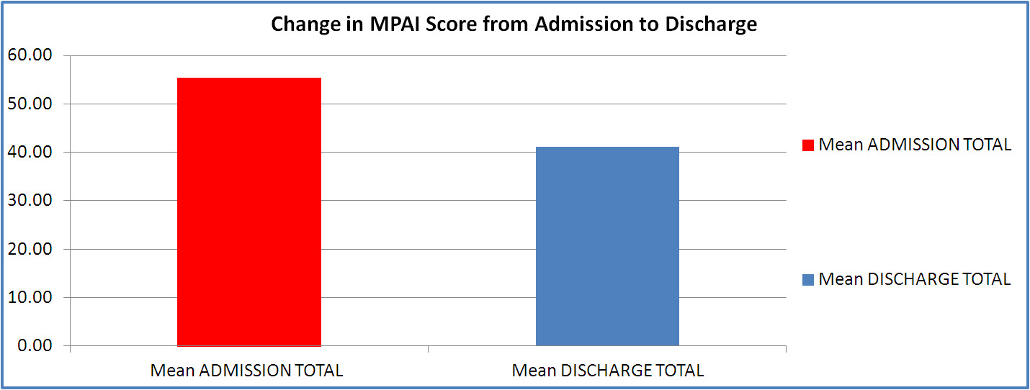
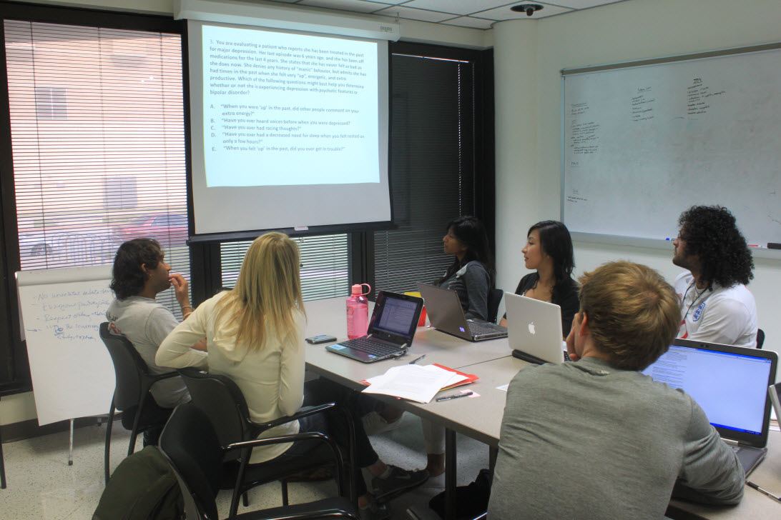
Poster Title Goes Here: Exactly As Was Submitted on Abstract
Author1, AB; Author2 CD; Author3 EF
Departments (sometimes superscripts are used on author names to match with different departments)
NAME OF INSTITUTION(S)
Your Logo
Section 3
Section 1
Section 3
Section 4
This is usually the Introduction or Rationale.
But, sometimes the instructions are to put an Abstract here. Try to keep this no more than a short paragraph, two max.
Click here to reveal the text box.
Often this is the Results section – the meat of your work. Remember, a poster is not a “manuscript on the wall.” Avoid making the poster too text-heavy. Ways to do this include:
  Use bulleted lines
  Use as few words as possible to make the point
  Add images or graphs or tables
  Present the most important findings, not necessarily every finding.
  Don’t be too afraid of white spaces
  xx
Click here to reveal the text box.
Usually Summary , Conclusions, or Significance go here
Sometimes “Next Steps” or “Future Plans”
Click here to reveal the text box.
Start by figuring out how wide your poster should be for this meeting. Adjust columns accordingly.
We recommend a sans serif font: (no tails on the letters)
Arial, Calibri, Microsoft Sans Serif
rather than a serif font (tails)
Times New Roman
Section 2
Insert a shape or text box
for added interest and highlighting
These blue section headers are a text box inside a shape box. Stretch both to fit the text, and keep the text box centered horizontally and vertically in the shape.
You can also change the color of the boxes.
Often this is the Methods section – tell your audience what you did.
  Use bulleted lines
  Make it easy for the readers
  Not too much heavy-text reading.
Click here to reveal the text box.
If appropriate and possible, present some of your findings in an image . This adds visual interest and helps tell the story of your work. Visitors to your poster do not want to read too much; they want to ‘get the story fast.’
Click here to reveal the text box.
Here is an extra text box, if you need one somewhere. Grab it and move it where you need it.
Click here to reveal the text box.
Go to View- Gridlines,
to snap on gridlines to help with centering
  Name your funding or sponsor source here. Add their Logos if you like.
  This poster template brought to you by pedi.edtech, faculty development program in Pediatrics, University of Texas Medical Branch
  sponsored by US Dept. Health & Human Services, Health Resources & Services Administration.

