Slide 1
You
Tube
for Teaching
Pediatric
Education Grand Rounds
March 29, 2013
Virginia Niebuhr, PhD
Mark Wolffarth, MD
Anne Rudnicki, EdD
Mary Jo Urbani, BA

Slide 2
  www.utmb.edu/pediedtech

Slide 3
What do you use YouTube for?
If you’re anything like me, the majority of the time it’s for . . .
http://youtu.be/RhKQfrE1KTE?t=1m10s

Slide 4
Perhaps YouTube has other applications
Has anyone used YouTube
to teach students or residents?
Let’s consider a scenario in clinic.

Slide 5
Perplexed student checking out . . .
HPI: Well, it’s a 1 y/o boy and mom says he’s been coughing non-stop for a few days. She thinks it sounds ‘croupy’. She also thinks his chest is rattling. Grandmother is in the room and says she thinks it sounds like ‘whooping cough’ but also thinks he’s been wheezing.
PE: No fever, he was playing on his mom’s phone the entire time I was in there and eating cheerios. No, he didn’t cough once, lungs sound clear.

Slide 6
OK, he has a cold . . .
Your student has never heard a child with croup or pertussis.
Maybe I can get into character or recreate the cough.
Or . . .
http://www.youtube.com/watch?v=Qbn1Zw5CTbA
http://www.youtube.com/watch?v=KZV4IAHbC48

Slide 7
Cool Stuff Available
New England Journal of Medicine
Infant Reflexes
British Medical Journal
Examination of the Infant
Dislocated Shoulder - US Navy Medical Video
TEDMED
Centers for Disease Control
Children’s National Medical Center
Notes:
NEJM – just the channel
Infant reflexes – whole video
BMJ – smell video
Examination of the infant
Dislocated shoulder navy video
TEDMED- publishing MIA
CDS
Children’s national medical center – a lot of parent stories

Slide 8
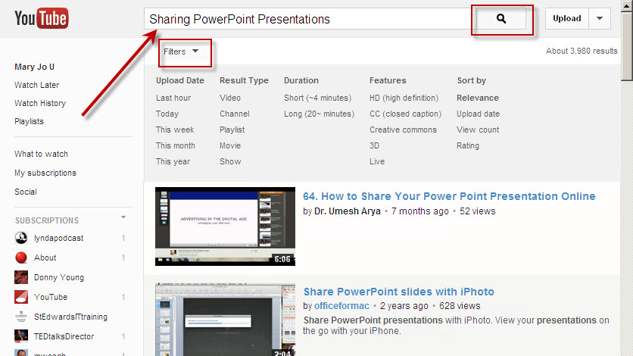
Search
Notes:
My searches center around technology; either I am learning something new for myself or trying to find content to teach others. You might be searching on things like “Croup Strider Barking Cough Examples” In any case, you type a phrase, keyword, or video title into the search bar.
From the results page, click Search Options to view filters and narrow your results. Use Related Search options to refine your search

Slide 9
What is an account?
It is your YouTube Login id/password. It is needed to save or upload videos to YouTube, so you can find them again easily.

Slide 10
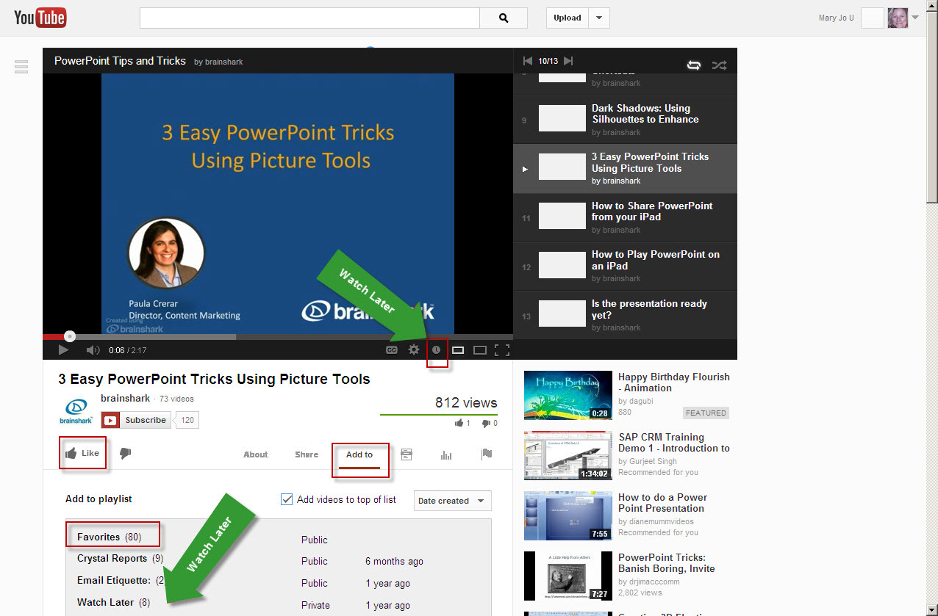
Save
Notes:
When you find what you like you can:
Like it by clicking the Thumbs Up signal.
Indicate you want to “watch it later” by clicking on the clock below the video
Add it to a variety of “lists” by clicking on the add to link and selecting:
Watch Later list or
Favorites or
New or existing Playlist

Slide 11
What is a Playlist?
In general, it is just a list of songs or videos that are strung together to play one after the other.
What is a Channel?
In general, it is your YouTube account’s home page. It is where your collection of videos is managed.

Slide 12
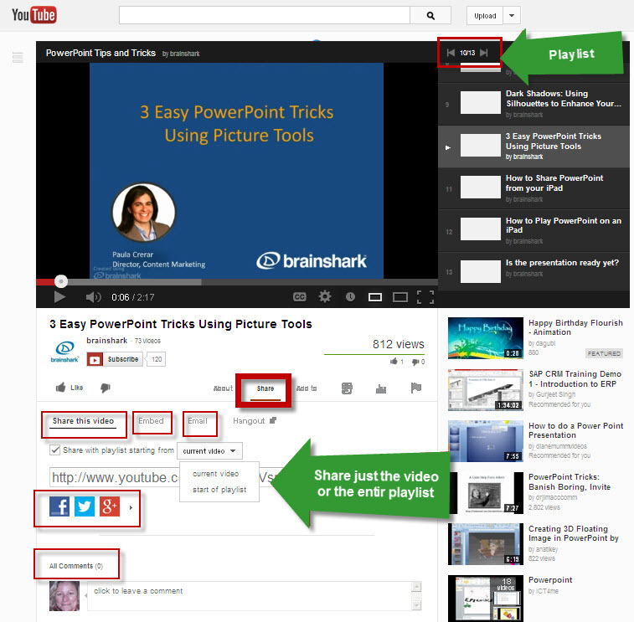
Share
Notes:
Often we want to share videos we have created or found with our colleagues or families. YouTube gives you all kinds of ways to share things.
Of course there is the ever more present facebook, twitter, google, + a whole lot more including my personal favorite, Pintrest. But if you are shy about these things you can always use the short URL, email or embed codes.
The short URL lets you start at a specific time in the video.
Embed code can be created to insert in web-pages or blogs and allows you to create a window of varying sizes.
Email will create and send an email from within YouTube.
You can leave comments on videos as well
And finally you can share playlists as easily as videos

Slide 13
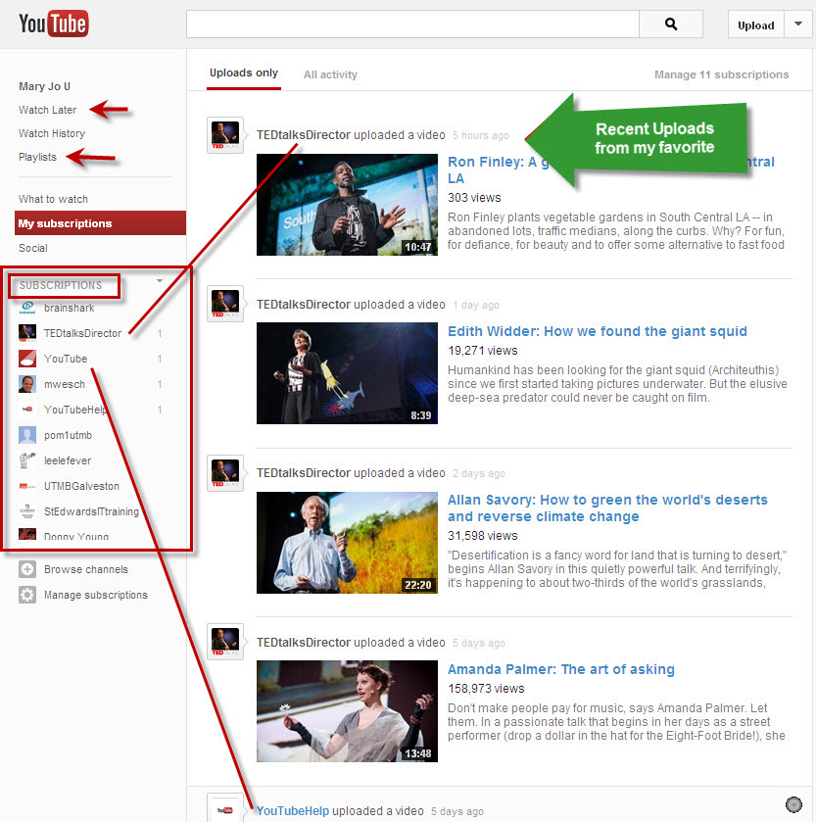
Subscribe
Notes:
If you really like a style of a learning videos or if you appreciate a person’s video log (vlog) perspective and you want to know when they post new content, you can subscribe to their channel.
Which of you have subscribed to channels you like? Which channels do you like for educational purposes?
Change your notification preferences by clicking "Manage X subscription". Personalize each subscription to get email notifications or just include new video activity.

Slide 14
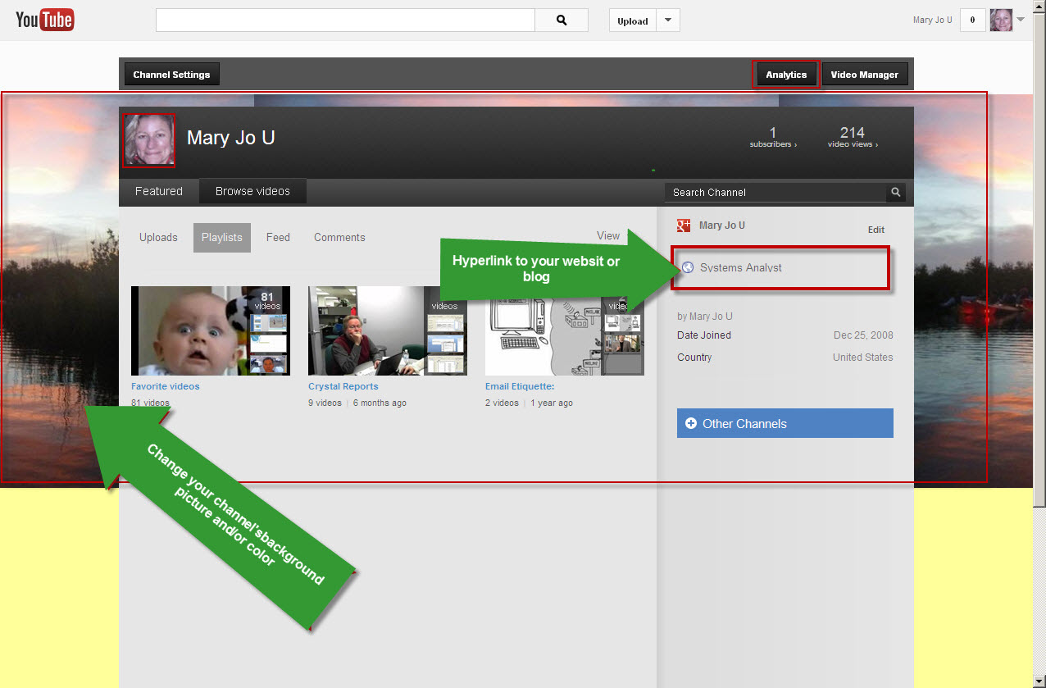
Customize your Channel
Notes:
You can change the background color and or picture
Add information about yourself
Add a hyperlink to your website or other relevant websites
View Analytical information about who is visiting you

Slide 15
Playlists
Similar to iTunes playlist
Can customize
Notes:
You can add videos to a playlist or create a new playlist by clicking the "Add to" button beneath the video. Playlist are much like music playlist where videos will run consecutively or in a randomly assigned order. When you place something in your watch later list or your Favorites, it is automatically placed in a Playlist under that name.
DEMO
Search on Croup Strider Cough Examples” ➔ Filter +Video +Short+ Relevance
Click on Watch Later for a few you think might be interesting
Put favorites in a play list called Croup
Video manager
Edit
Croup
Arrange them
Add commentary to your lists
Add a video to a playlist from the video watch page or from the video manager
From the video watch page, just click the Add To Button
Add to existing playlist or create a new one
From the video manager page, just select the videos you want and click the add to button
From the video manager you can edit the playlists in all kinds of ways
You can change the sort, add commentary of your own with capture and even trim the videos you have so you only get the part you want.
You can even change the title of your keyword or add tags
You can choose which video thumbnail will be your playlist thumbnail.
Share your playlist the same way you share everything else on youtube, by hiting th share button.
Often when you watch a video, it is a playlist or a video in a playlist series. These lists can be referred to or embedded or emailed just like a single video.

Slide 16
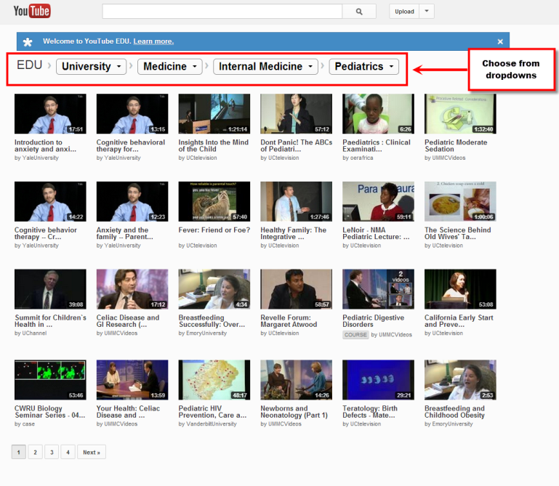
Searching YouTube EDU

Slide 17
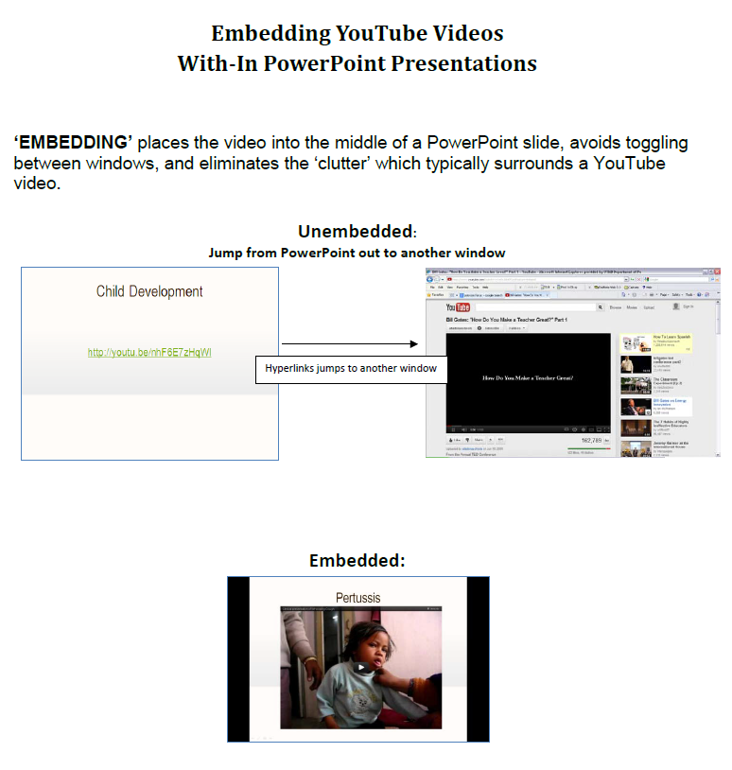
Embed
unembedded
vs.
embedded
Notes:
Discuss the differences then explain about PPT not working with embedding at the moment. And we’re not sure why. So, if you use a link to a youtube video, make sure you will have a reliable internet connection

Slide 18
Putting it all together
  Example
  – shorten lengthy clips, organize and introduce videos
  Ow, My Shoulder
Notes:
You can see evidence of me using YouTube for self instrcution, by my playlists.
It is great for that, but it is also a great way to share content with students in a classroom or as homework in the case of “flipping” a classroom.

Slide 19
YouTube for Teaching
www.utmb.edu/pediedtech
Instructional Technology section

