Slide 1
The University of Texas Medical Branch
School of Medicine Academic Affairs
All Employee Meeting
Wednesday, March 20, 2019
Notes:
Thank you for joining me today to discuss the results of the 2018 You Count Employee Survey and how we can work together to make the workplace better for our patients and ourselves.

Slide 2
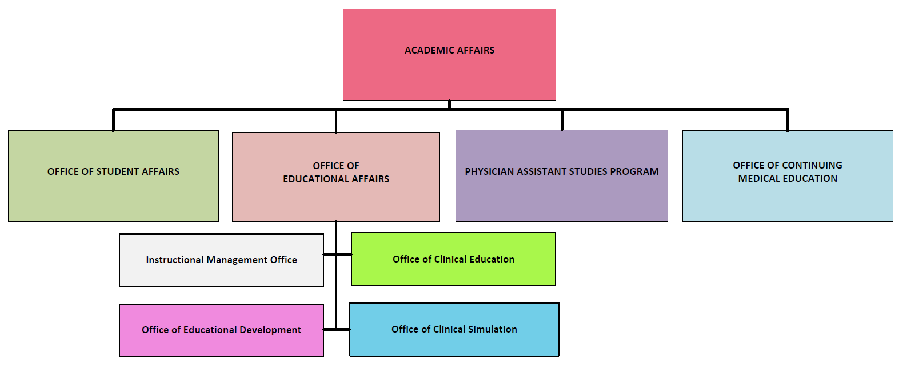
Academic Affairs
Notes:
Academic Affairs departmental org chart

Slide 3
Academic Affairs: You Count Update
TASK #1-Utilize the Weekly Relay to recognize individuals in Academic Affairs
TASK #2-Create a modified GEM Card program for Academic Affairs to recognize individuals in Academic Affairs
TASK #3-Utilize Academic Affairs Quarterly Meetings
TASK #4-Develop an online career development and cross learning portal as a “one-stop-shop” for opportunities and information
Notes:
On October 2, 2018, we met to go over the You Count results. Then teams were formed and those teams left with a charge of addressing the opportunities identified from the You Count Survey. On November 14, 2018, we met and the teams came back with four tasks to be addressed. The large group then prioritized the tasks via voting.

Slide 4
Academic Affairs: You Count Update Continued
TASK #1-Utilize the Weekly Relay to recognize individuals in Academic Affairs
Academic Affairs Spotlight – January 2019
As of March 2019, 11 out of 77 Academic Affairs employees have submitted their information
TASK #2-Create a modified GEM Card program for Academic Affairs to recognize individuals in Academic Affairs
Academic Affairs All-Star Award (AAA Award)
As of February 2019, 12 AAA Awards have been earned
Notes:
TASK #1 – The Weekly Relay Spotlight was unveiled January 15, 2019. We have sent out 3 emails regarding this opportunity (the latest one last week). It was created to gather information about Academic Affairs employees in order to highlight them and share a little about what they do. To date we have received 11 out of 77 submissions.
TASK #2 – The Academic Affairs All-Star Award (or Triple A Award) was unveiled February 7, 2019. It has been created to recognize employees within Academic Affairs for going above and beyond. Employees can be recognized by peers, subordinates and supervisors for their outstanding work. Employees who receive at least AAA Award will be recognized at the All AA Employee meetings. The final meeting we will have a drawing and three winners will be selected to attend a luncheon hosted by Dr. Mouton.

Slide 5
Academic Affairs: You Count Update Continued
TASK #3-Utilize Academic Affairs Quarterly Meetings
First Meeting today (March 20, 2019)
TASK #4-Develop an online career development and cross learning portal as a “one-stop-shop” for opportunities and information
X
Notes:
TASK #3 – Having Academic Affairs Quarterly Meetings for the purpose of disseminating information and giving recognition for all areas in Academic Affairs was the outcome of task 3. Today is the first of the meetings. Later in this presentation, we will discuss if we want to try to have them quarterly, or if we want to change the meetings to 2 or 3 times per year.
TASK #4 – Task four charged us with creating an online portal as a one-stop-shop for career development and cross-learning across the departments within Academic Affairs. Mr. Steven Wilson has worked hard to create this resources for us. Steven, please stand so we can give you a round of applause. It is still in the test environment, but we are very close to rolling it out so that each of you may utilize it. Stay tuned because it is right around the corner!!
Now I would like to give the other areas within Academic Affairs and opportunity to talk about their shops. Please welcome Ms. Brenda Johnson, who is the Director of the Office of Continuing Medical Education.

Slide 6
Continuing Medical Education (CME): Mission
The UTMB Office of Continuing Education is committed to the development of high quality educational activities for physicians and other health care providers, which promote the continued improvement of clinical, teaching, and research skills as part of a lifelong learning process.

Slide 7
CME: Where We Are
CME Provider
The University of Texas Medical Branch at Galveston is accredited by the Accreditation Council of Continuing Medical Education (ACCME) to provide continuing medical education for physicians.

Slide 8
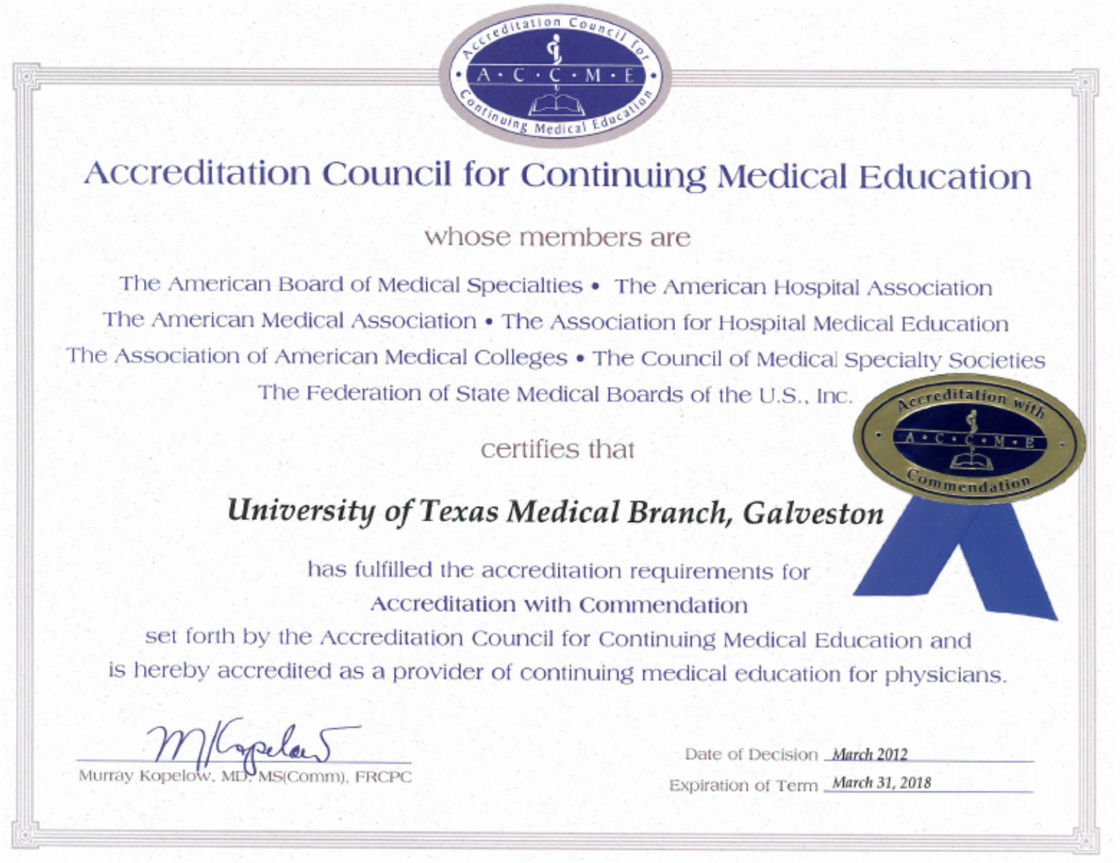
CME: Where We Are

Slide 9
CME: Where We Are
Owners of Credit System
American Medical Association
Physicians Recognition Award
AMA PRA Category 1 Credit
The University of Texas Medical Branch at Galveston designates this live activity for a maximum of 17.5 AMA PRA Category 1 Credits™. Physicians should claim only the credit commensurate with the extent of their participation in the activity.

Slide 10
CME: Where We Are
2017-2018 CME Activities
Activity Type | Quantity
Regularly Scheduled Series (Grand Rounds, Tumor Boards, QA Conferences, etc.) | 54
Courses/Symposiums | 50
Conferences | 5
Enduring Materials | 2
TOTAL | 111

Slide 11
CME: Where We Are
Our Customers
UTMB
Others
American Correctional Association
Baptist Hospitals of Southeast Texas
Houston Medical Society
International Council of Motorsport Science
Family Center, Bermuda
Medicus of Houston
University of Houston

Slide 12
CME: Where We Are
How the CME Office is Funded
Cost recovery
Fee for services to cover our operational costs

Slide 13
CME: Where We Are
Educational Grants
Total amount of educational grants awarded for CME events in FY2017
$88,750

Slide 14
CME: Where We Are
2017 Reported Statistics
Total CME Hours awarded – 2,290
Total # physician participants – 41,500
Total # of other participants – 7,900

Slide 15
CME: Where We Are
How to get CME credit
Complete an application
br2johns@utmb
Continuing.ed@utmb.edu
CME Director reviews
CME Staff person follows up with applicant
Agenda
Speaker/planner info
Marketing
link to our website to claim credit

Slide 16
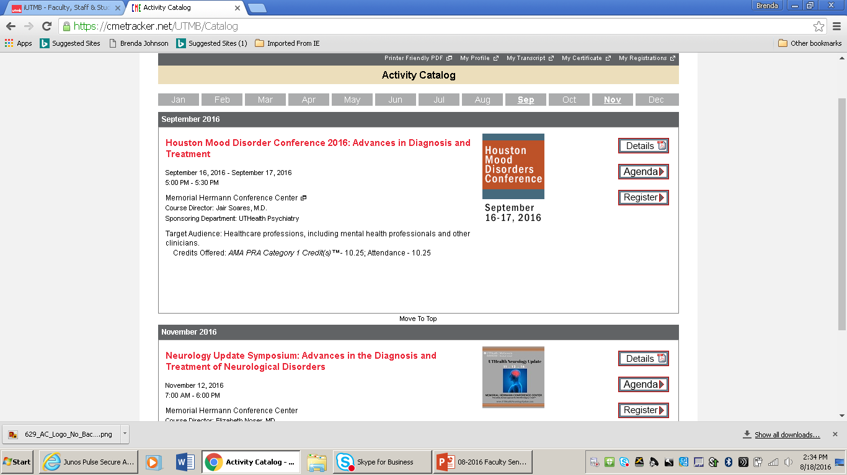
CME: Where We Are
http://cmetracker.net/UTMB

Slide 17
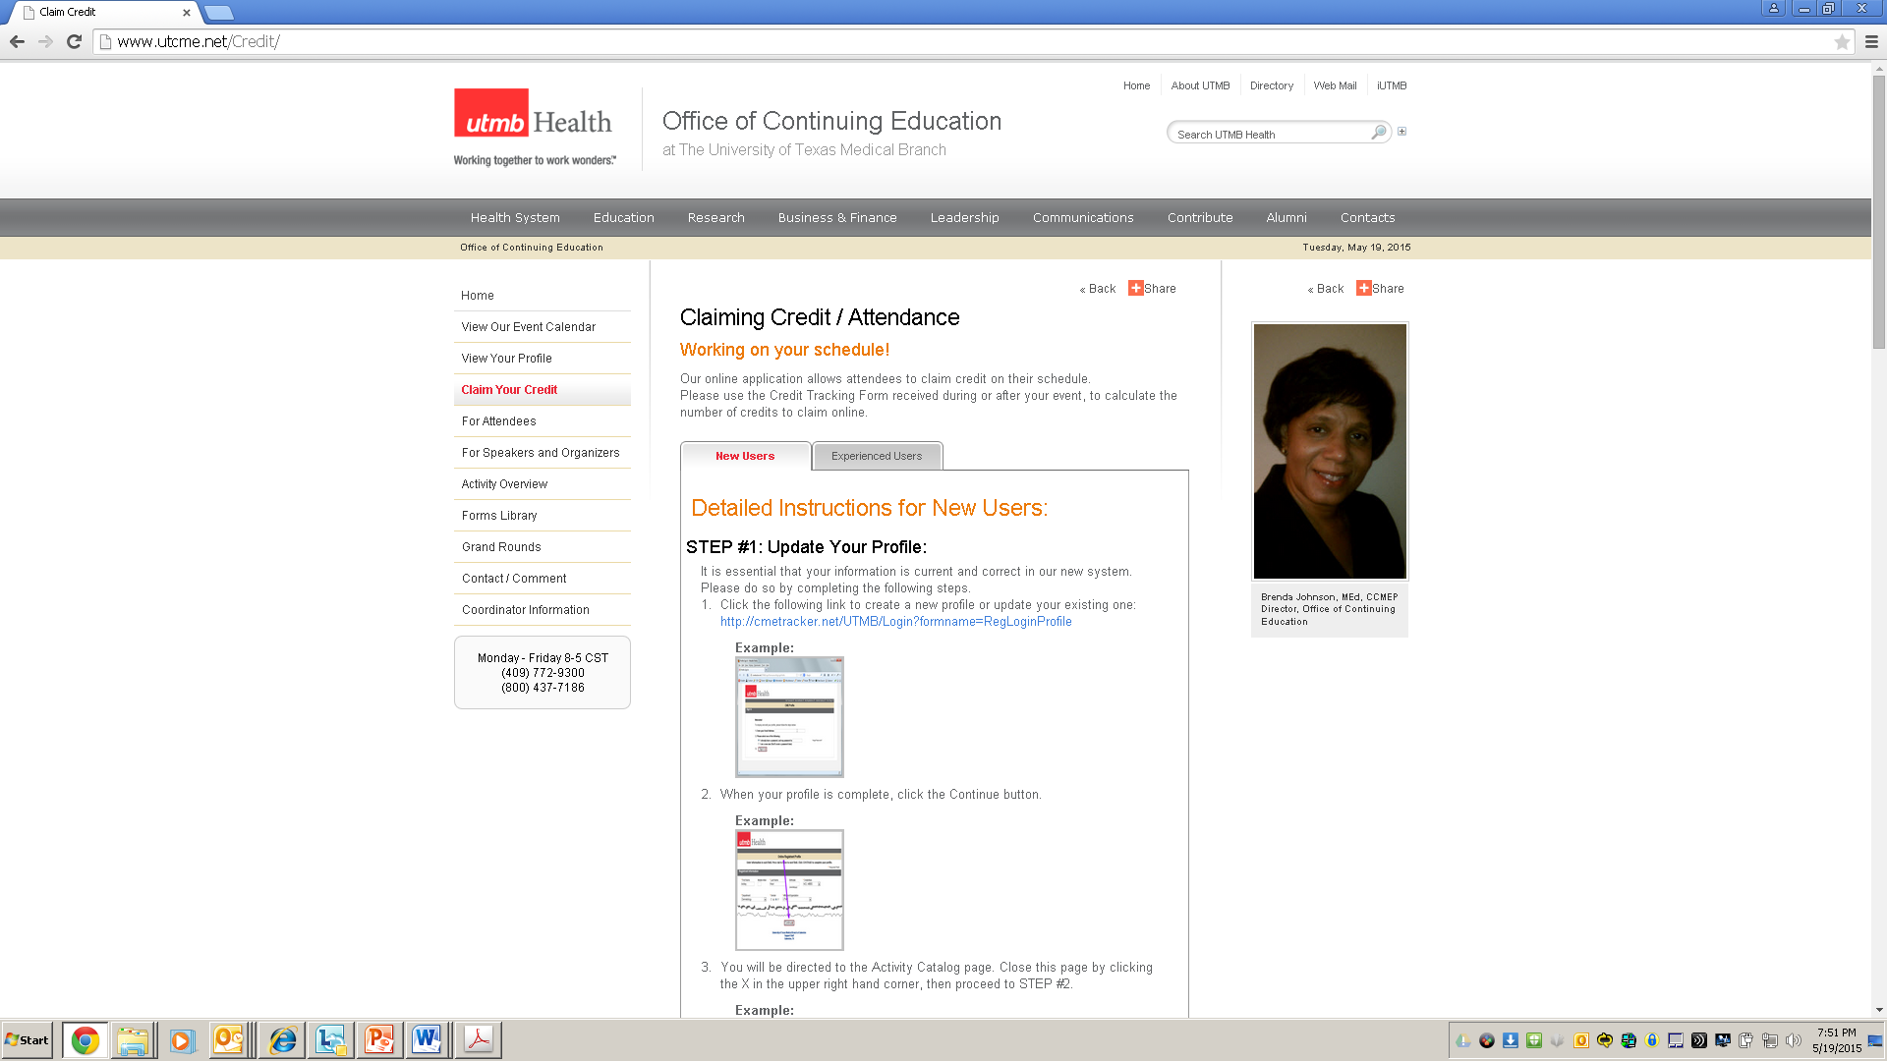
CME: Where We Are
CME Website: www.UTCME.net

Slide 18
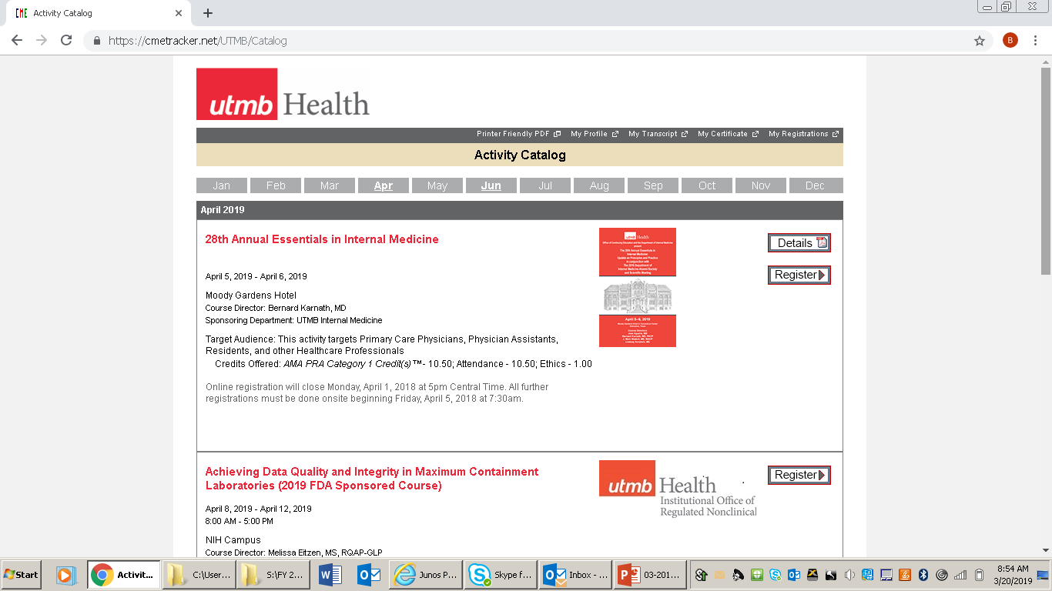
CME: Where We Are
www.utCME.net

Slide 19
CME: Where We Are
24/7 Online Access to CME Transcript
https://cmetracker.net/UTMB

Slide 20
CME: Where We Are
CME Staff
Brenda Johnson, MEd, CHCP, Director
br2johns@utmb.edu 409-772-9305
Lois Carter, MBA, CME Specialist
Lpcarter@utmb 409-772-9308
Lorraine Terrell Davis, CME Coordinator
Loterrel@uth.tmc.edu 409-772-9307

Slide 21
Educational Affairs: Mission
Educational Affairs oversees the School of Medicine curriculum for each of the four years of medical education at UTMB. Educational Affairs comprises four departments that work together as a team to integrate basic science with clinical knowledge and skills through each of the four years of medical education.

Slide 22
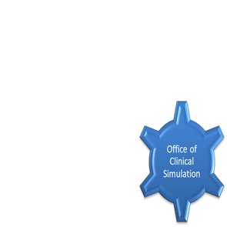
Educational Affairs: Where We Are
Educational Affairs
Office of Clinical Education
Office of Educational Development

Slide 23
Educational Affairs: Where We Are Going
Instructional Management Office
Office of Clinical Education
Office of Educational Development
Change
Educational Affairs
New Normal

Slide 24
Student Affairs & Admissions (OSAA): Mission
The mission of the Office of Student Affairs and Admissions is to recruit and matriculate promising and academically talented students from a diverse population across Texas and the nation. We provide resources, student support, and mentoring to graduate well-trained professionals committed to life-long learning, who will become compassionate physicians serving the healthcare needs of all.

Slide 25
OSAA: Where We Are
Admissions:
Incoming class GPA-3.9 MCAT-509
Percentage URM-27%
Academic Support & Career Counseling
Dr. Stacy Shields is our senior learning specialist providing individual support, oversight of tutoring and mentoring programs, and workshops to SOM students
Dr. Norma Pérez is revising and expanding the advising program
Dr. Robin Mallett provides additional support and guidance
Student Affairs
We continue to oversee orientation, white coat, match, graduation, as well as creation of MSPEs

Slide 26
OSAA: Where We Are Going
Admissions
Increasing outreach to students in other states to enrich diversity
Use of CASPer to incorporate situational judgement into admissions decisions
Academic Support & Career Counseling
Posted position of Director of Academic Support and Career Counseling, and also looking to recruit another learning specialist to enhance academic support services
Expanding and enriching advising program to all 4 years, and combining with revitalized curriculum
Student Affairs
Combining many functions with PA school
Revising way we do MSPE to improve functionality
Moving many functions of orientation to online

Slide 27
Physician Assistant Studies: Mission
The Mission of the Physician Assistant Program is
“ To develop and graduate academically and clinically exceptional physician assistants.”

Slide 28
Physician Assistant Studies : Where We Are
PA Program Goals
Maintain an applicant pool consisting of at least 24% first generation college students.
Maintain a 95% or better three-year average graduation rate for students entering the UTMB PA program.
Maintain at least 50% of clinical rotation sites in low income zip codes (as defined by the Centers for Medicare and Medicaid Services).
Maintain a five-year first time PANCE pass rate above the national average.
Notes:
Maintain an applicant pool consisting of at least 24% first generation college students. * The applicant pool for the cohort entering the UTMB PA program in 2018 was 20%.
Maintain a 95% or better three-year average graduation rate for students entering the UTMB PA program. *As of 2018 the three-year average graduation rate for UTMB PA program is 97%
Maintain at least 50% of clinical rotation sites in low income zip codes (as defined by the Centers for Medicare and Medicaid Services). *As of 2018 over 59% of clinical rotations were in low income zip codes.
Maintain a five-year first time PANCE pass rate above the national average. * The five-year national mean first time taker average pass rate is 98% * The five-year mean first time taker average pass rate for the UTMB PA Program is 96%

Slide 29
Physician Assistant Studies : Where We Are
PA Program Goals
Maintain an applicant pool consisting of at least 24% first generation college students. 20%
Maintain a 95% or better three-year average graduation rate for students entering the UTMB PA program.
Maintain at least 50% of clinical rotation sites in low income zip codes (as defined by the Centers for Medicare and Medicaid Services).
Maintain a five-year first time PANCE pass rate above the national average.
Notes:
Maintain an applicant pool consisting of at least 24% first generation college students. * The applicant pool for the cohort entering the UTMB PA program in 2018 was 20%.
Maintain a 95% or better three-year average graduation rate for students entering the UTMB PA program. *As of 2018 the three-year average graduation rate for UTMB PA program is 97%
Maintain at least 50% of clinical rotation sites in low income zip codes (as defined by the Centers for Medicare and Medicaid Services). *As of 2018 over 59% of clinical rotations were in low income zip codes.
Maintain a five-year first time PANCE pass rate above the national average. * The five-year national mean first time taker average pass rate is 98% * The five-year mean first time taker average pass rate for the UTMB PA Program is 96%

Slide 30
Physician Assistant Studies : Where We Are
PA Program Goals
Maintain an applicant pool consisting of at least 24% first generation college students. 20%
Maintain a 95% or better three-year average graduation rate for students entering the UTMB PA program. 97%
Maintain at least 50% of clinical rotation sites in low income zip codes (as defined by the Centers for Medicare and Medicaid Services).
Maintain a five-year first time PANCE pass rate above the national average.
Notes:
Maintain an applicant pool consisting of at least 24% first generation college students. * The applicant pool for the cohort entering the UTMB PA program in 2018 was 20%.
Maintain a 95% or better three-year average graduation rate for students entering the UTMB PA program. *As of 2018 the three-year average graduation rate for UTMB PA program is 97%
Maintain at least 50% of clinical rotation sites in low income zip codes (as defined by the Centers for Medicare and Medicaid Services). *As of 2018 over 59% of clinical rotations were in low income zip codes.
Maintain a five-year first time PANCE pass rate above the national average. * The five-year national mean first time taker average pass rate is 98% * The five-year mean first time taker average pass rate for the UTMB PA Program is 96%

Slide 31
Physician Assistant Studies : Where We Are
PA Program Goals
Maintain an applicant pool consisting of at least 24% first generation college students. 20%
Maintain a 95% or better three-year average graduation rate for students entering the UTMB PA program. 97%
Maintain at least 50% of clinical rotation sites in low income zip codes (as defined by the Centers for Medicare and Medicaid Services). 59%
Maintain a five-year first time PANCE pass rate above the national average.
Notes:
Maintain an applicant pool consisting of at least 24% first generation college students. * The applicant pool for the cohort entering the UTMB PA program in 2018 was 20%.
Maintain a 95% or better three-year average graduation rate for students entering the UTMB PA program. *As of 2018 the three-year average graduation rate for UTMB PA program is 97%
Maintain at least 50% of clinical rotation sites in low income zip codes (as defined by the Centers for Medicare and Medicaid Services). *As of 2018 over 59% of clinical rotations were in low income zip codes.
Maintain a five-year first time PANCE pass rate above the national average. * The five-year national mean first time taker average pass rate is 98% * The five-year mean first time taker average pass rate for the UTMB PA Program is 96%

Slide 32
UTMB PA Program PANCE Results

Slide 33
Physician Assistant Studies: Where We Are Going
Accreditation
At its July 2017 meeting, the Accreditation Review Commission on Education for the Physician Assistant (ARC-PA) placed the University of Texas Medical Branch Physician Assistant program, sponsored by the University of Texas Medical Branch, on Accreditation-Probation status until its next review in June 2019.
ARC-PA Site Visit is scheduled for 25-26 March 2019
Faculty has been re-organized to better facilitate continuity and succession.
Curriculum is being evaluated and revised to include more Supervised Clinical Practice Experiences.

Slide 34
Academic Affairs Wrap Up
Quarterly Meetings
2 times per year
3 times per year
4 times per year
Mission
Notes:
As promised previously, let’s discuss how many times per year we would like to have the Academic Affairs meetings.

Slide 35
ACADEMIC AFFAIRS ALL-STAR AWARD RECIPIENTS
Notes:
Now, I would like to take the last few moments of our meeting to recognize those individuals who have received Academic Affairs All-Star Awards.

Slide 36
Academic Affairs All-Star Award
CONGRATULATIONS
Alma Block
Administrative Secretary
Educational Affairs

Slide 37
Academic Affairs All-Star Award
CONGRATULATIONS
Valerie Carmichael
Administrative Associate
Student Affairs

Slide 38
Academic Affairs All-Star Award
CONGRATULATIONS
Lori DeWillis
Assistant Administrator
Academic Affairs

Slide 39
Academic Affairs All-Star Award
CONGRATULATIONS
Miles Farr
Assistant Dean
Clinical Education

Slide 40
Academic Affairs All-Star Award
CONGRATULATIONS
Catherine Hale
Administrative Coordinator
Educational Affairs

Slide 41
Academic Affairs All-Star Award
CONGRATULATIONS
Shaine LeGrand
Program Manager
Clinical Education

Slide 42
Academic Affairs All-Star Award
CONGRATULATIONS
Kenisha Moore
Clinical Skills Training Coordinator
Instruction Management Office

Slide 43
Academic Affairs All-Star Award
CONGRATULATIONS
Berengaria Navarre
Sr. Business Coordinator
Student Affairs

Slide 44
Academic Affairs All-Star Award
CONGRATULATIONS
Norma Pérez
Director, SOM Special Programs
Student Affairs

Slide 45
Academic Affairs All-Star Award
CONGRATULATIONS
Catalina Salinas
Coordinator I
Physician Assistant Studies

Slide 46
Academic Affairs All-Star Award
CONGRATULATIONS
Trea Smith
Business Coordinator
Student Affairs

Slide 47
Academic Affairs: Questions

